Slide 1
IDEAL Research & IDE Workshop
IDEAL Research
Donita C. Brady, Ph.D.
Harrison McCrea Dickson, M.D. and Clifford C. Baker, M.D. Presidential Associate Professor, Department of Cancer Biology
Assistant Dean for Inclusion, Diversity and Equity in Research Training
August 19, 2022
www.med.upenn.edu/idealresearch
Twitter & Instagram: @IDEAL_Research

Slide 2
Penn Medicine IDEAL^{XP} Est. 2021
What?:
An enhanced structure for a unified education office focused on inclusion, diversity, and equity.
Who?:
Support our diverse community of learners by cultivating a culture of equitable inclusivity across all PSOM education programs: Biomedical Graduate Studies (BGS), Biomedical Postdoctoral Programs (BPP), Master’s and Certificate Programs (MaC), Medical Scientist Training Program (MSTP), and Undergraduate Medical Education (UME).
How?:
Address the individual and group needs of marginalized students and postdocs in a deliberate and focused manner.
Engage all learners for the purpose of creating an inclusive and anti-racist climate at PSOM through education and training.
www.med.upenn.edu/idealresearch Twitter & Instagram: @IDEAL_Research
www.med.upenn.edu/idealmed Twitter: @PennMedPDI

Slide 3
Principles of Inclusion, Diversity, & Equity in Penn Medicine Research Community
Inclusion is our commitment to initiatives, strategies, and behaviors within the Penn Medicine research training community that allow for respectful engagement and embracement of the diversity of its members.
Diversity is the variations in identities that exist within the Penn Medicine research training community with an emphasis on increasing the representation of individuals that have been traditionally disadvantaged or are historically underrepresented in research and medicine.
Equity is our implementation of policies that ensure members of the Penn Medicine research training community from marginalized identities have access to the same opportunities to grow, contribute, and develop within it.
www.med.upenn.edu/idealresearch
Twitter & Instagram: @IDEAL_Research

Slide 4
IDEAL Research: Mission, Objectives, & Vision
The Mission of IDEAL Research is to ensure alignment between innovation and impact in biomedical research with a commitment to inclusion, diversity, and equity that is necessary for research excellence by valuing, engaging, and embracing the diversity of identity within the Penn Medicine research community and ensuring access to opportunities to individuals from marginalized identities to grow, contribute, and develop within it.
The Objectives of IDEAL Research are:
i) Provide research training opportunities to undergraduates and post-baccalaureate scholars
ii) Recruit the next generation of biomedical research trainees
ii) Establish community driven support networks for trainee advocacy
iv) Facilitate opportunities for community engagement and outreach
v) Lead in grant administration and program evaluation
The Vision of IDEAL Research is to create, nurture, and maintain a Penn Medicine research community that embodies diversity, values inclusivity, and promotes equity.
www.med.upenn.edu/idealresearch
Twitter & Instagram: @IDEAL_Research

Slide 5
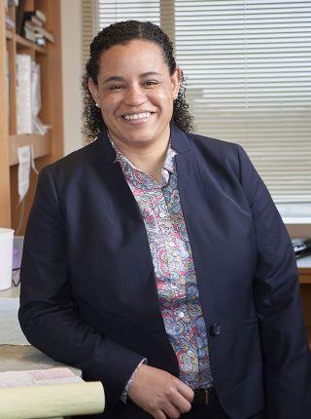
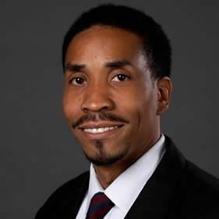
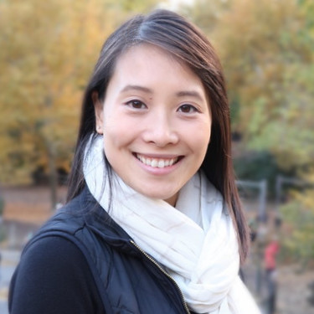
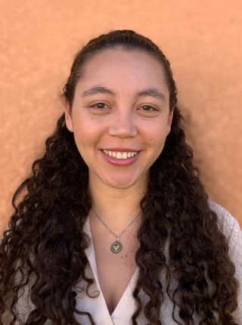
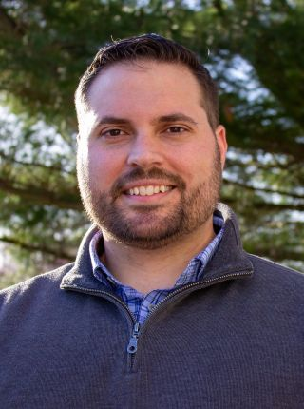
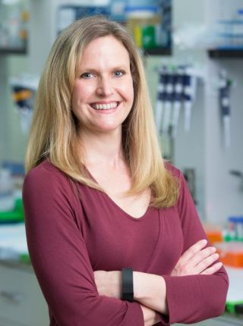
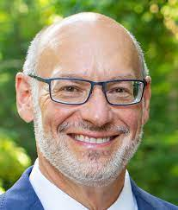
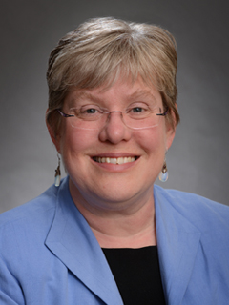
IDEAL Research: Our Team
Donita C. Brady Ph.D.
Assistant Dean for
Inclusion, Diversity, & Equity in Research Training
Faculty Co-Director, SUIP
Ed Marshall, M.S.
Administrative Director
Lisa Lim-Pahl, M.A.
Assistant Director for
Research Training
Programs
Vanessa Martinez Penn
Administrative Coordinator
Paul Tichenell, Ph.D.
Assistant Director of
Trainee Recruitment
Faculty Co-Director, SUIP
Kelly Jordan-Sciutto, Ph.D.
Faculty Co-Director, PREP
Dan Kessler, Ph.D.
Faculty Co-Director, PREP
Janis Burkhardt, Ph.D.
Faculty Director, PennPORT
www.med.upenn.edu/idealresearch
Twitter & Instagram: @IDEAL_Research

Slide 6
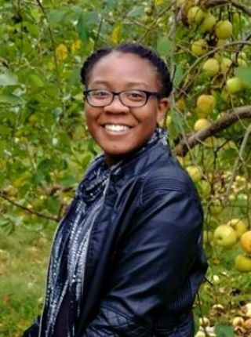
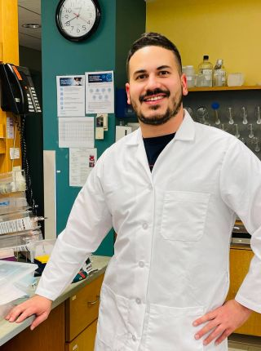
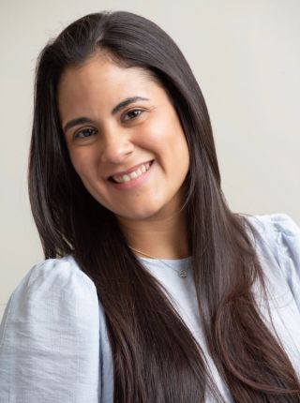
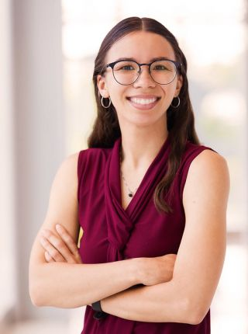
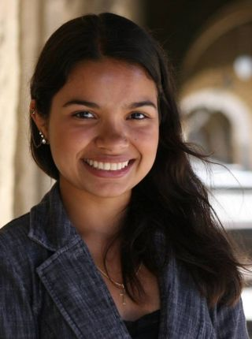
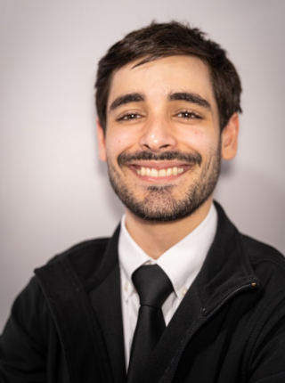
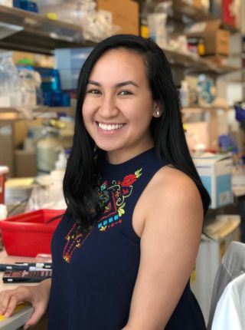
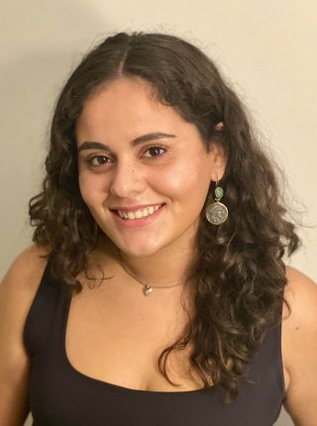
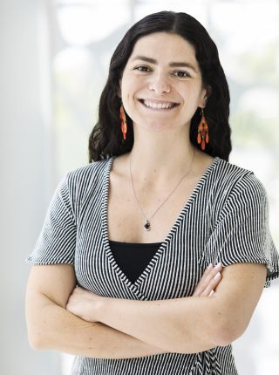
IDEAL Research Fellows
Facilitate SUIP and Penn PREP program design with Assistant Director of Research Training Programs, Lisa Lim, and Faculty Directors of SUIP and Penn PREP
Serve as research training mentors and professional development guides for SUIP interns and Penn PREP scholars
Support recruitment activities at national symposia and recruit visits to HBCUs, MSIs, and other colleges and universities.
Serve as members of Trainee Advocacy Alliance that provides provides trainee support for diverse members of the Penn Medicine research training community, especially those holding identities that are historically underrepresented in the biomedical sciences.
Maya Hale
IDEAL Research Lead PREP Fellow
Franklin D.
Staback-Rodriguez
IDEAL Research Lead SUIP Fellow
Kyabeth Torres-Rodriguez
IDEAL Research Lead Trainee Recruitment Fellow
Aimee Farria, Ph.D.
Bailey Nance
Emily Stephanie
Cribas
Jose J. Gorbea
Colon
Kahealani (Kahea)
Uehara
Maria Fernanda
Carrera Rodriguez
Vanessa Fleites
www.med.upenn.edu/idealresearch
Twitter & Instagram: @IDEAL_Research

Slide 7
IDEAL Research Signature Objectives
Research & Educational Training Programs
SUIP
PennPREP
PennPORT
www.med.upenn.edu/idealresearch
Twitter & Instagram: @IDEAL_Research
Notes:
The University of Pennsylvania Summer Undergraduate Internship Program is a 10-week intensive summer research opportunity for undergraduate students. Interns will be matched with a Principal Investigator (PI) based on shared research interests. Throughout their time at Penn, interns will work with PIs and other lab mentors to develop laboratory and research skills essential for future graduate school experiences. In addition to laboratory work, interns will participate in seminars that will enrich their understanding of science, participate in professional development workshops, graduate school preparation seminars, and have the opportunity to present at the SUIP Symposium. SUIP is designed for students who aim to pursue a PhD or an MD-PhD in biomedical studies.
The University of Pennsylvania Post-Baccalaureate Research Education Program (PennPREP) offers a one-to-two-year research experience for students who have completed their bachelor’s degree, are interested in pursuing a doctoral degree in the biomedical sciences, and would benefit from protected time to develop additional skills research. The program provides a full time research experience in a biomedical science discipline, along with preparation for applying to and succeeding in graduate school.
Penn - Postdoctoral Opportunities in Research and Teaching (PennPORT), an NIH sponsored, Institutional Research and Academic Career Development Award (IRACDA) postdoctoral fellowship, supported by the NIH division of NIGMS awarded August 2007.
The NIH sponsored PennPORT program combines a traditional mentored postdoctoral research experience at the University of Pennsylvania with a mentored teaching experience at a partnering institution. The Program is designed to provide an opportunity for postdoctoral appointees to develop their teaching skills. An integral part of the program is formal instruction in pedagogical methods from the University of Pennsylvania Center for Teaching and Learning. Postdocs will also be able to take advantage of the many research and career success skills training programs provided by Biomedical Postdoctoral Programs (BPP).
The partnering institutions are Delaware County Community College, Lincoln University and Rutgers University Camden Campus. All institutions are minority serving institutions in the Philadelphia locality. The PennPORT program is intended to enhance research-oriented teaching at partner institutions, foster collaboration in research and teaching between the faculty at the University of Pennsylvania and that of partner minority-serving institutions, and encourage undergraduates to enter a career in biomedical research. Since we wish to provide role models for the undergraduates at our partner institutions, candidates from underrepresented groups are encouraged to apply.

Slide 8
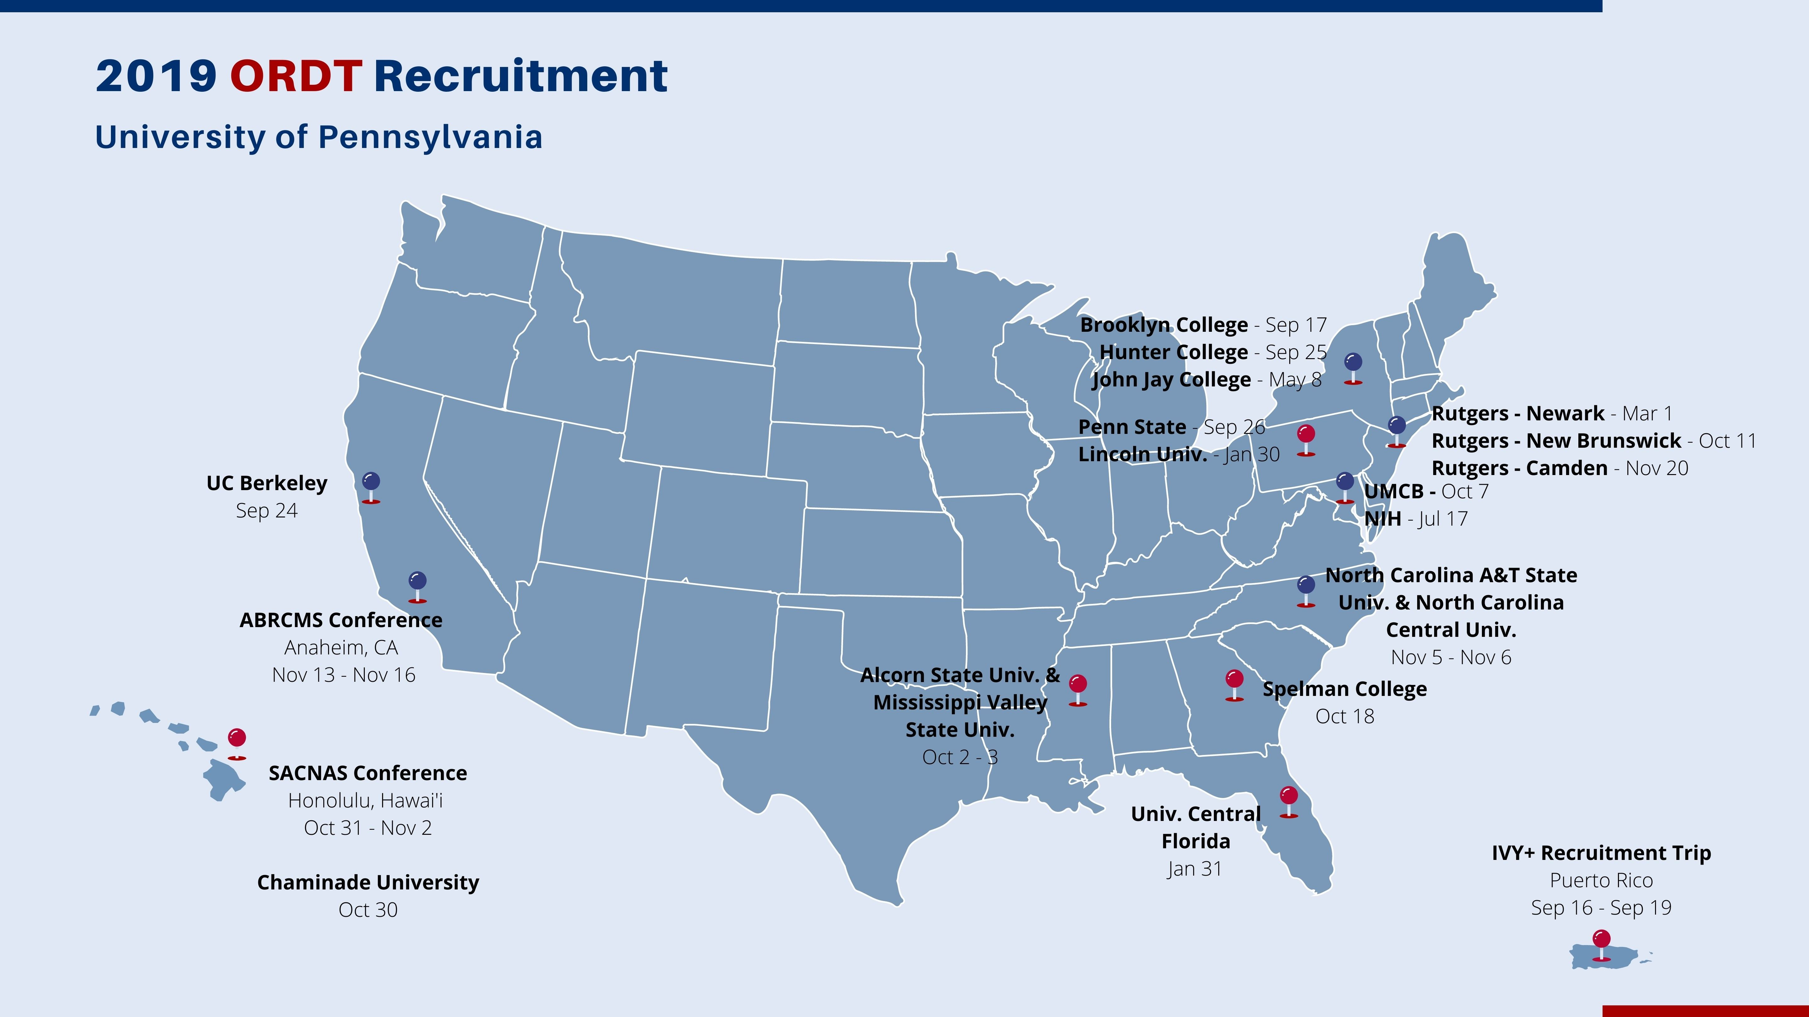
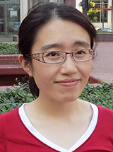
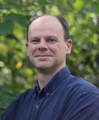
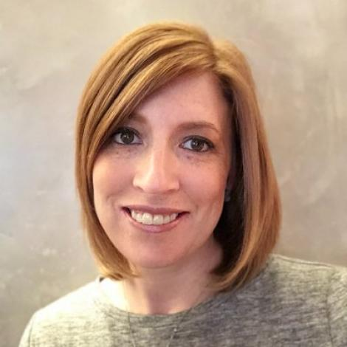
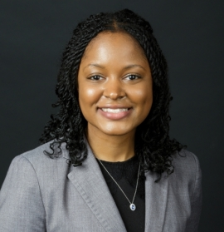
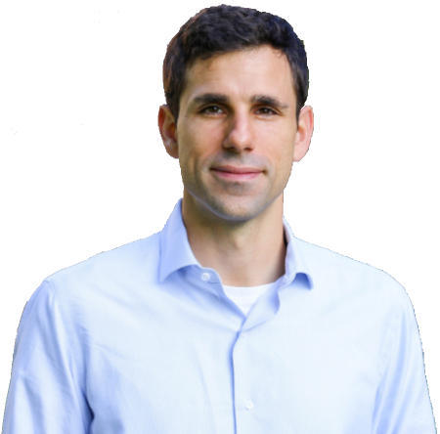
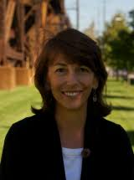
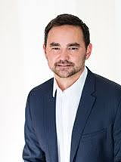
IDEAL Research Initiatives
Recruitment Ambassadors Program
RA Leadership
BMB/CPM
IDEAL Research
BMB/CPM
CB
DSRB
GCB
G&E
GGEB
GCB/GGEB
IGG
MVP
NGG/PGG
NGG/PGG
PGG
www.med.upenn.edu/idealresearch/taa
Twitter & Instagram: @IDEAL_Research
Notes:
Time Commitment:
Serve for a 3-Year Term
Term start September 2021
4 days one Fall of term for ABCRMS or SACNAS
1 hr/month for Fall recruitment (October- December)
6 hrs each February for SUIP admissions
3 hrs each March for PREP admissions
1 hr/month for Summer Boot Camp for incoming BGS students (June- August)
Upfront Training (2hrs total):
Inclusive mentoring
Responsibilities:
Support recruitment activities at national symposia and recruit visits to HBCUs, MSIs, and other colleges and universities.
Participate in selection of SUIP and PREP interns interested in graduate group or subprogram discipline.
In future, support development of and participate in graduate group and program specific incoming diverse trainee boot camps.

Slide 9
IDEAL Research Initiatives
TAA is a network of graduate students and faculty members from across BGS committed to providing support to trainees from backgrounds historically excluded from science, especially when they are facing discrimination or distress.
All TAA members complete trainings in:
Restorative Justice
Inclusive Mentorship
Racial Literacy
iCare
www.med.upenn.edu/idealresearch/taa
Twitter & Instagram: @IDEAL_Research

Slide 10
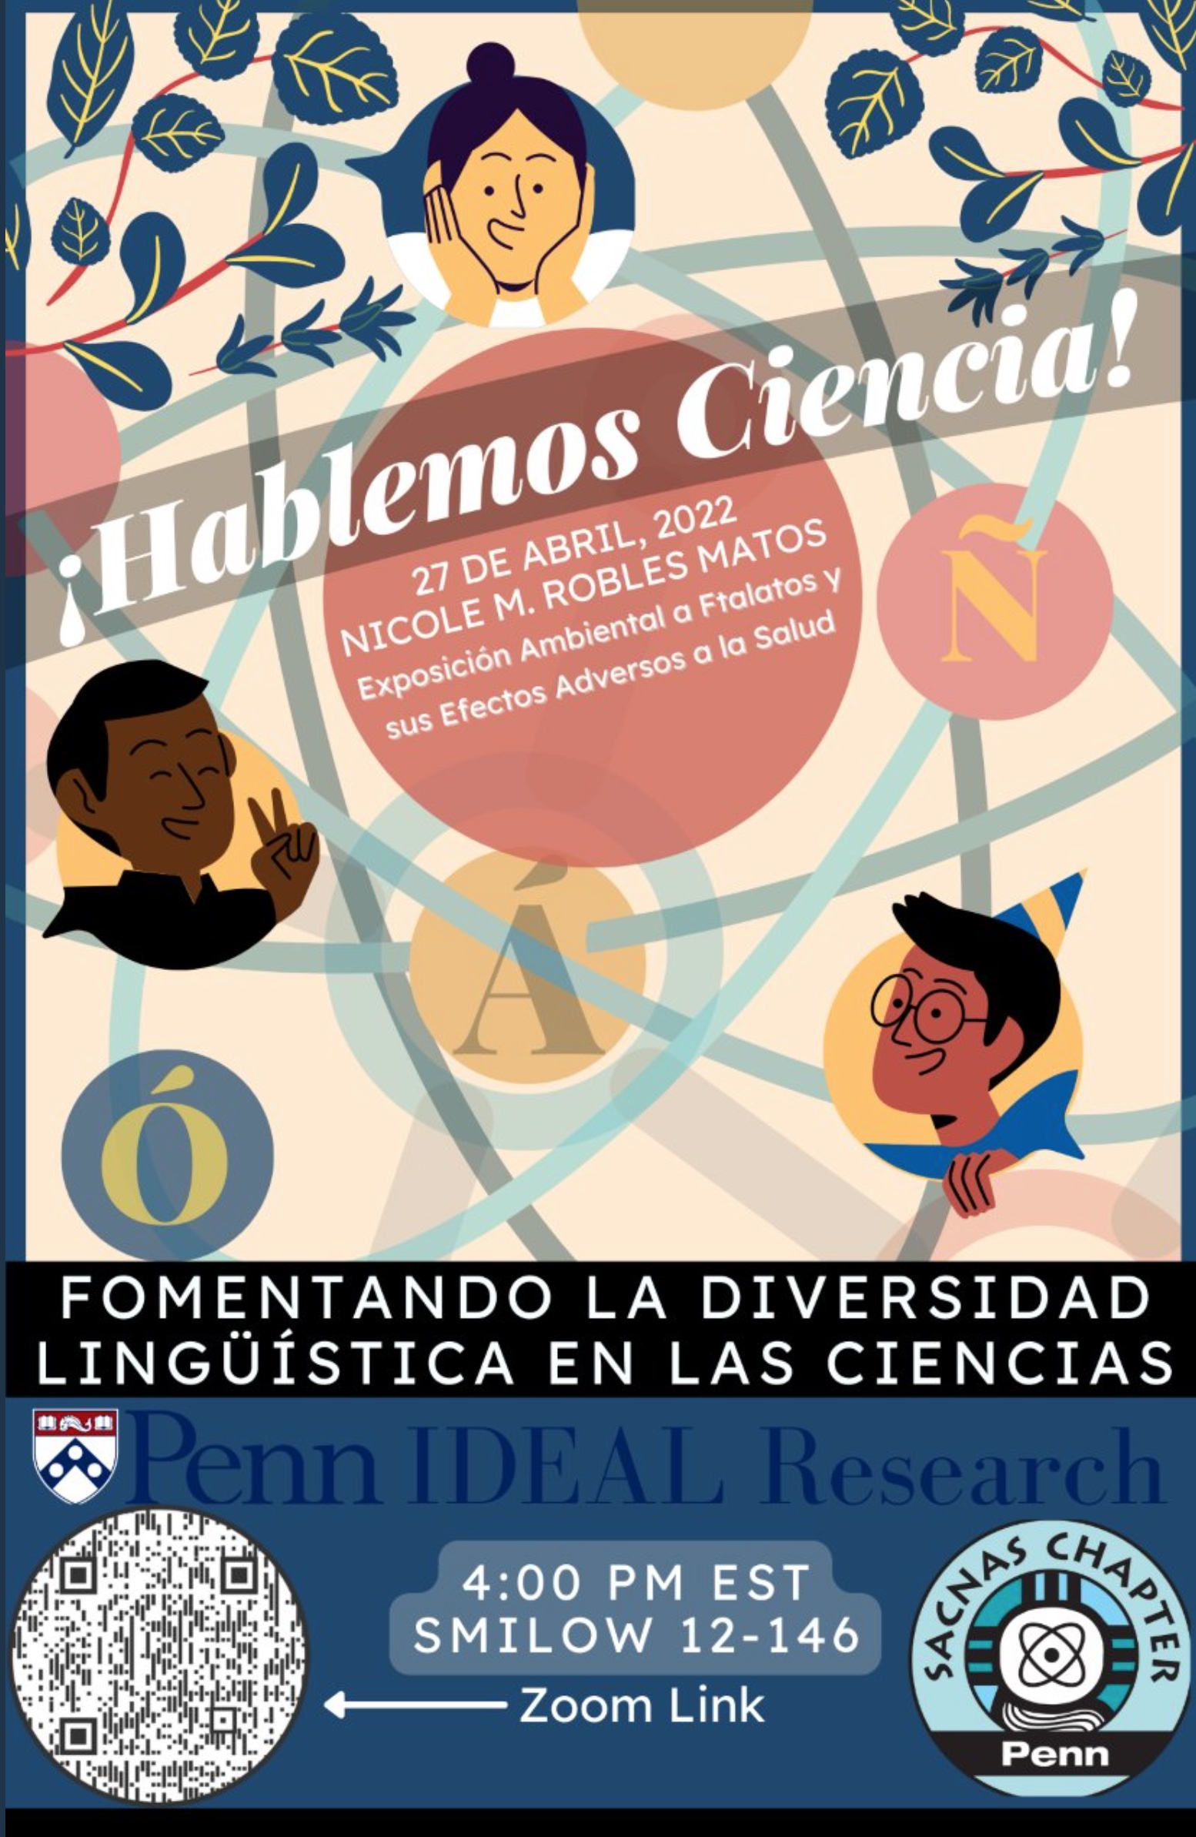
IDEAL Research Collaborations
Trainee Affinity Groups
IDE Events
www.med.upenn.edu/idealresearch
Twitter & Instagram: @IDEAL_Research

Slide 11
IDEAL Research: Contact Us
Web: www.med.upenn.edu/idealresearch
Twitter: @IDEAL_Research
Instagram: @IDEAL_Research
Donita Brady: bradyd@pennmedicine.upenn.edu
Ed Marshall: edward.marshall@pennmedicine.upenn.edu
Lisa Lim-Pahl: lisa.lim@pennmedicine.upenn.edu
Vanessa Martinez Penn: vanessa.martinezpenn@pennmedicine.upenn.edu
www.med.upenn.edu/idealresearch
Twitter & Instagram: @IDEAL_Research

Slide 12
Trainee Advocacy Alliance
An IDEAL Research Initiative
Jillian Eisenhauer
Robin Wilder
August 19, 2022
www.med.upenn.edu/idealresearch/taa
Twitter & Instagram: @IDEAL_Research

Slide 13
Who Are We?
TAA is a network of graduate students and faculty members from across BGS committed to providing support to trainees from backgrounds historically excluded from science, especially when they are facing discrimination or distress.
All TAA members complete about 12 hours of trainings in:
Restorative Justice
Inclusive Mentorship
Racial Literacy
iCare
www.med.upenn.edu/idealresearch/taa
Twitter & Instagram: @IDEAL_Research

Slide 14
Mission Statement
The Trainee Advocacy Alliance (TAA) is a collaborative group of Biomedical Graduate Studies (BGS) graduate students, Biomedical Postdoctoral Program (BPP) post-docs, and Penn faculty members from across the University who are committed to creating, nurturing, and maintaining a Penn biomedical research community that embodies inclusivity, diversity, and equity. With the full support and access to resources within IDEAL Research, TAA will provide trainee support for diverse members of the Penn Medicine research training community, especially those holding identities that are historically underrepresented in the biomedical sciences. TAA is a resource for trainees experiencing racial, gender, other identity-based biases and/or is seeking support to navigate a path forward for other reasons. TAA members are available to offer trainees personal support and guidance in a confidential manner and without any need for escalation. Members can also provide referral to official Penn resources and reporting or mediation services.

Slide 15
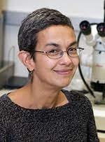
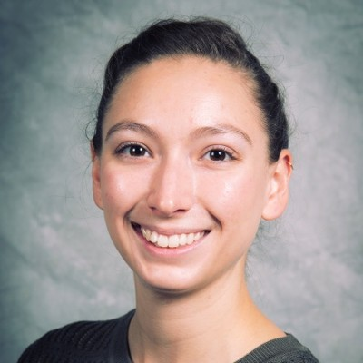
TAA Leadership Team
Meera
Sundaram
(faculty)
Jill
Eisenhauer
(student)
Valerie Estela-Pro
(postdoc)
Dan
Kessler
(faculty)
Robin
Wilder
(student)
Vanessa Martinez
(Admin Coord)

Slide 16
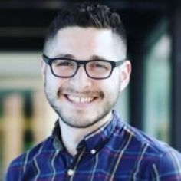
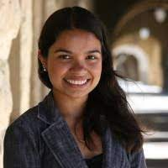
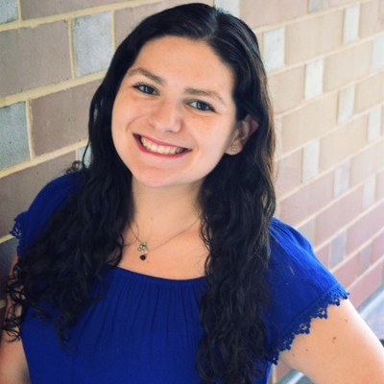
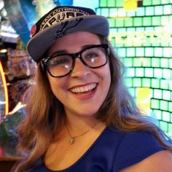
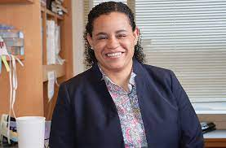
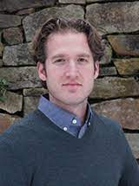
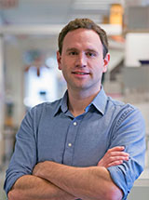
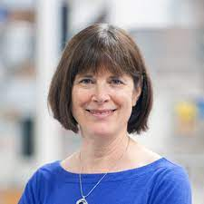
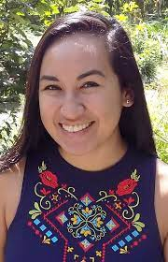
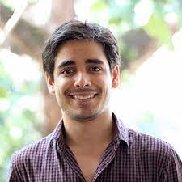
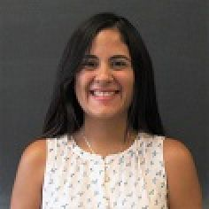
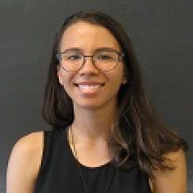
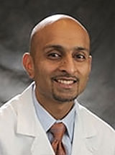
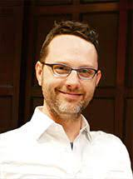
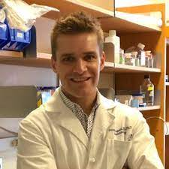
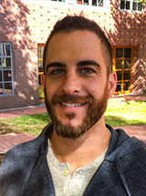
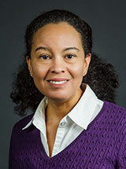
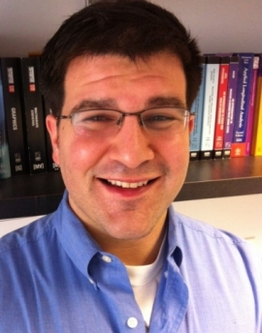
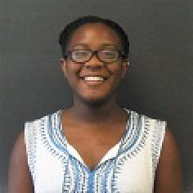
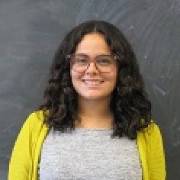
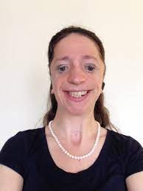
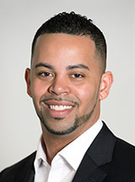
Feel free to reach out
MVP
MVP
MVP
NGG
IGG
BMB/
CB/PGG
BMB
CB/IGG
BMB/
CB/PGG
CPM
DSRB
BMB
BMB
CB
CB
CB
CPM
DSRB
GCB
G&E
G&E/NGG
GGEB
GGEB
DSRB
DSRB
G&E
GGEB
GTV/
IGG/PGG
IGG/MVP
IGG/MVP
IGG/MVP
IGG/MVP
MVP
GTV
GTV
IGG
IGG
IGG
MVP
IGG/
MVP/PGG
G&E/PGG/
NGG/
www.med.upenn.edu/idealresearch/taa
Twitter & Instagram: @IDEAL_Research

Slide 17
When can we help?
Any time a trainee is facing discrimination, distress, or conflict related to or informed by their identity as a member of a historically excluded group.
Examples:
A PI who interrupts and talks over his female lab members
An instructor who makes fun of an international student’s accent
A lab mate who uses racist or homophobic slurs
TAA is also a resource for those facing other struggles during their time as a BGS student.
Struggling in 1st year classes
Unsure of how to contact PI’s for rotations or discuss rotation expectations
Work life balance struggles
Etc.
www.med.upenn.edu/idealresearch/taa
Twitter & Instagram: @IDEAL_Research

Slide 18
What can we do?
Provide a supportive environment to discuss the incident
Provide guidance & planning
Email review
Role playing
Referral to official Penn resources
Connection to mediation services
Direct intervention or mediation
Incident reporting (only if desired)
www.med.upenn.edu/idealresearch/taa
Twitter & Instagram: @IDEAL_Research

Slide 19
How do I get help from TAA?
1) Email TAA directly
Vanessa will directly pair you with a TAA member, either student, faculty, or post-doc
2) Email a TAA member directly
On our website there are member profiles that have contact information, personal background, and experiences.

